Slide 1

Notes:
provide feedback form link after event + have two people on the doors asking for feedback next wrokshop: evaluating your model + overfitting and underfitting + optimization/hypterparameter tuning next next workshop: label encoding, feature selection filling missing values 1) finish code 2) math 3) improve design 4) kaggle prep 5) check what is missing

Slide 2
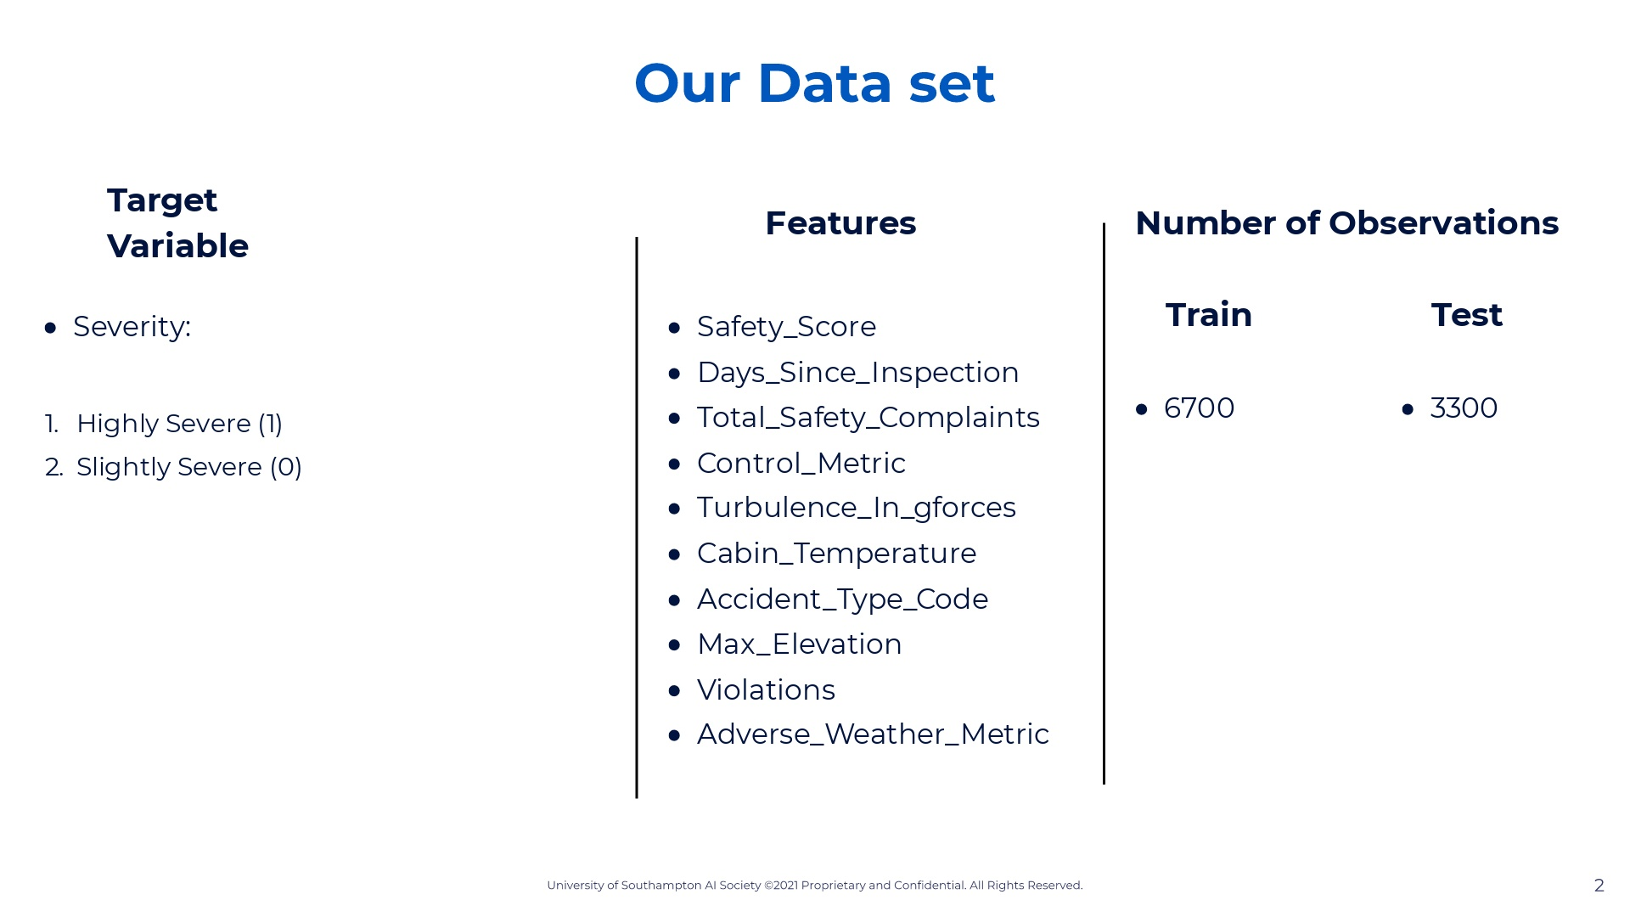
Notes:
Note that our data is all labelled. So for each observation we know how much was charged. In other words we know how much each patient paid. So we know this is a supervised learning problem. To simplify the explanation lets assume that 1 and 4 are 1 and 3 and 1 are 0 so we have a binary classifier during this workshop

Slide 3
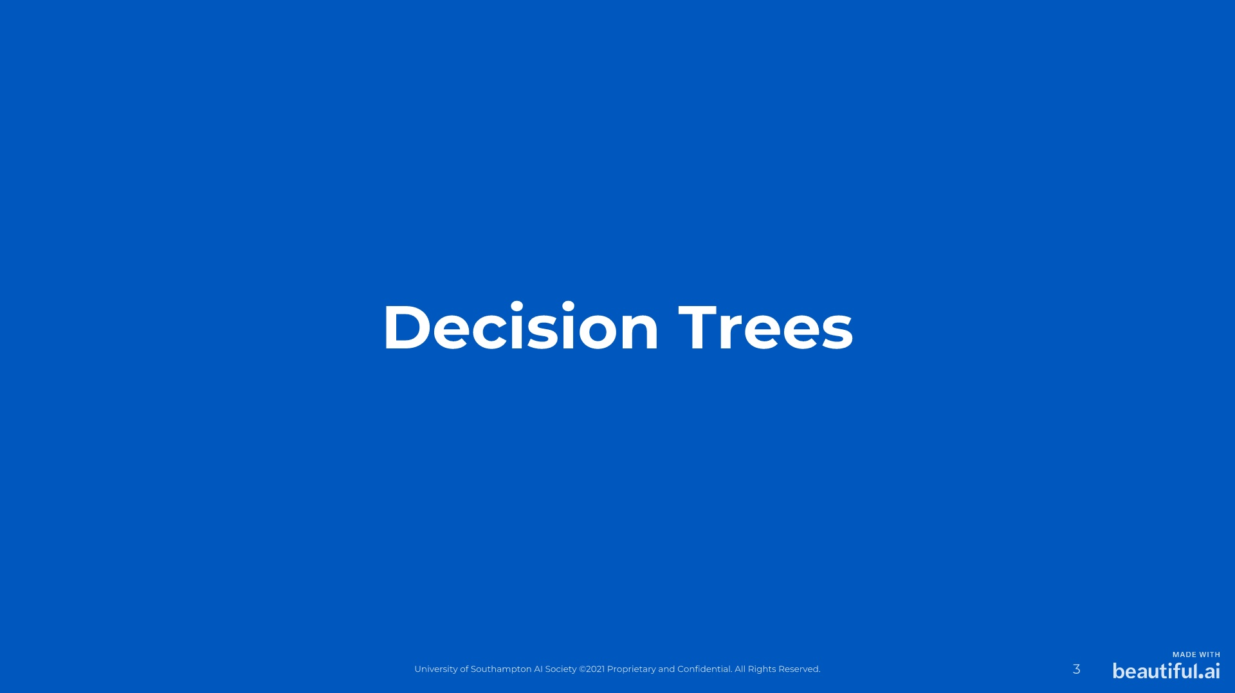
Notes:
Now this section is where we'll go over the mathematical equations for those of you who are interested. We won't be deriving everything in detail but will explain the mathematical process involved as this will cater between people who do want to know this and those who don't. Those who want further derivations i'll be providing links for such in our github which you can find in our linktree.

Slide 4
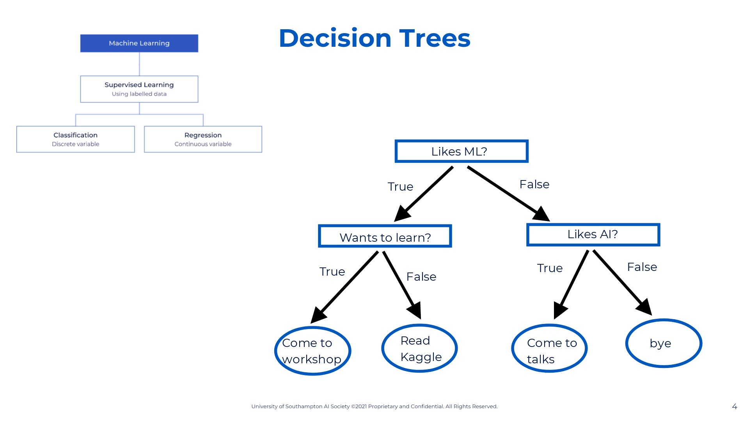
Notes:
A decision tree is a type of machine learning algorithm that creates a predictive model by learning simple decision rules from prior data. Decision trees are a supervised machine learning algorithm. This means that all our features and target variables are labelled, aka there are no missing values. Now in supervised algorithms there are regression model, where our target variable is continuous (ie. car price) and classification models, where our target variable is discrete (ie. car type). Decision trees actually fall under both of these, meaning that decision trees can be used for regression problems and classification problems. So immediately we can see one very powerful thing about decision trees. Let's look at a very simple classification decision tree here which is about whether someone should join AISoc or not. We begin by asking checking if they like ML. If yes, then we check if they want to learn about ML. If yes then the output is come to workshop. If not then the output is read kaggle. Let's go back to the if they like ML. Let's go through the false path. If they dont like ML we check if they like AI. If they do then they should come to talks, if not then goodbye because I have no recommendation. Therefore in this simple example we had a target variable with four classes: come to workshop, read, come to talks, bye. In order to reach one of the answers we used three features: likes ML, wants to learn, and likes AI. CHANGE: the example decision tree could be done on workshop data

Slide 5
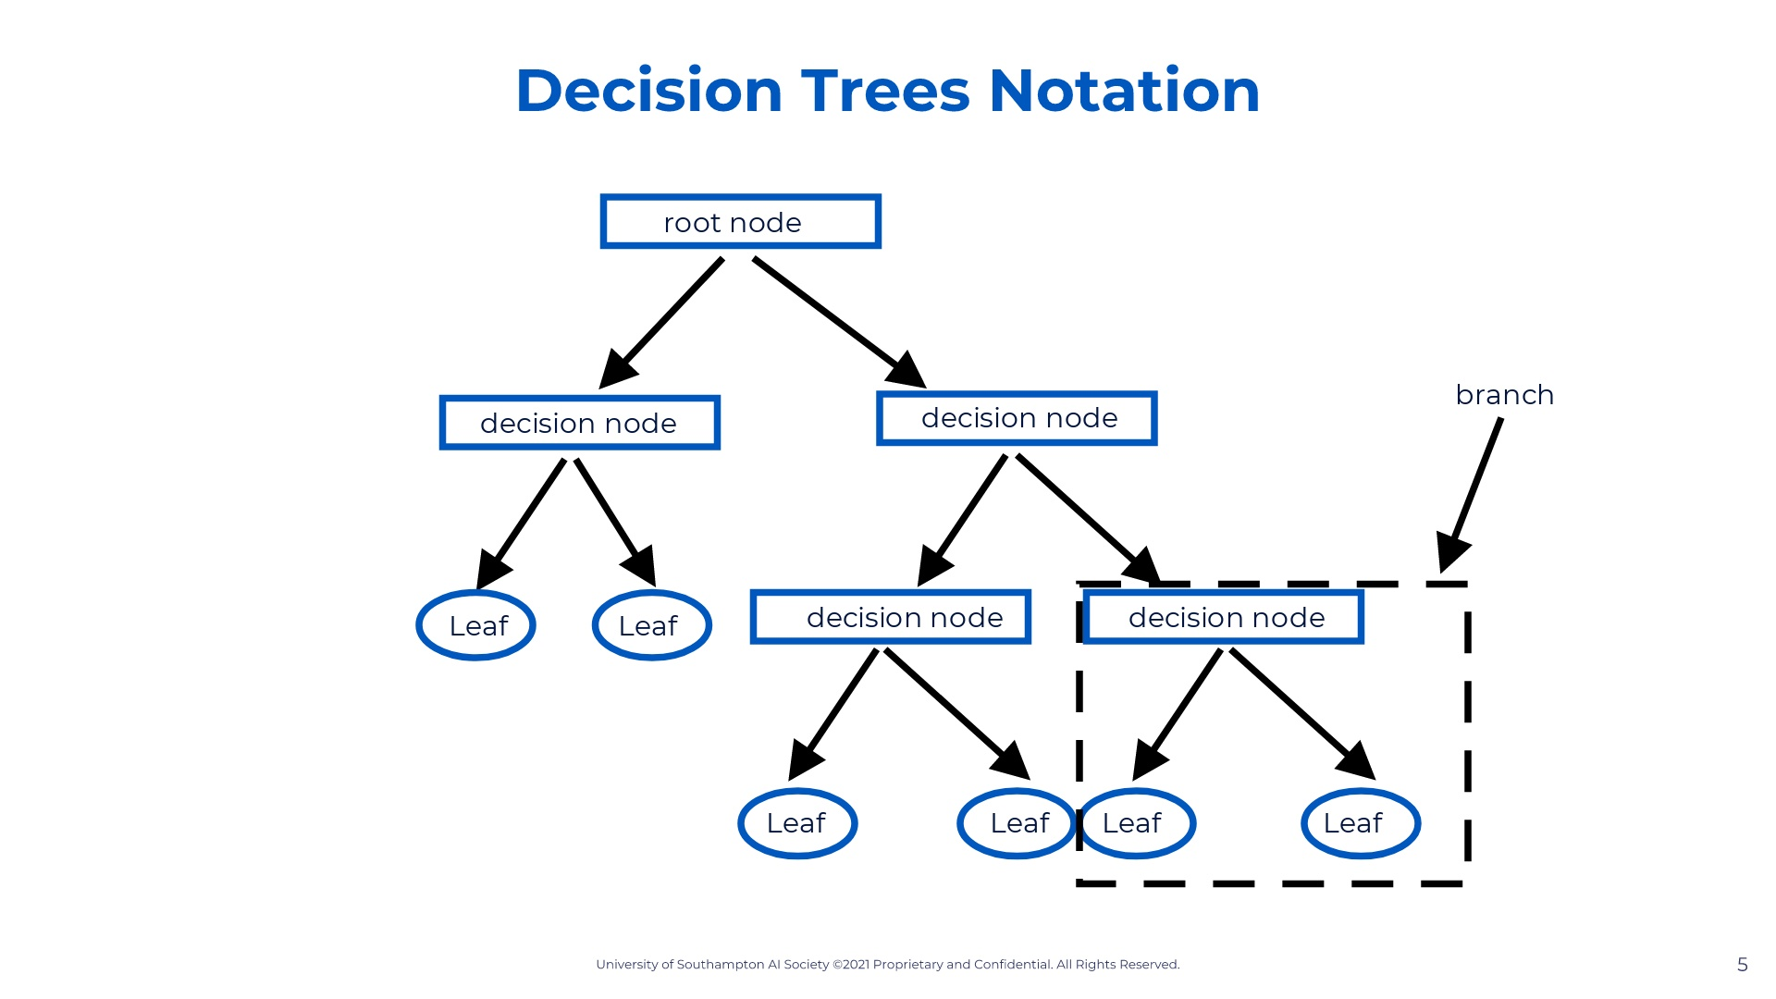
Notes:
This is what a decision tree looks like. The number of decision nodes and leaf nodes vary depending on your algorithm but this is the general idea. Let's go over some notation so we can communicate with each other precisely. root node - the first feature we begin with decision node - the following feature leaf node - is a decision, meaning we can't break our tree down anymore branch - the decision and leaf nodes together So now that we have established what decision trees are and what they do lets actually go into the steps on developing a tree. First thing we need to do is identify what feature will be in our root node.

Slide 6
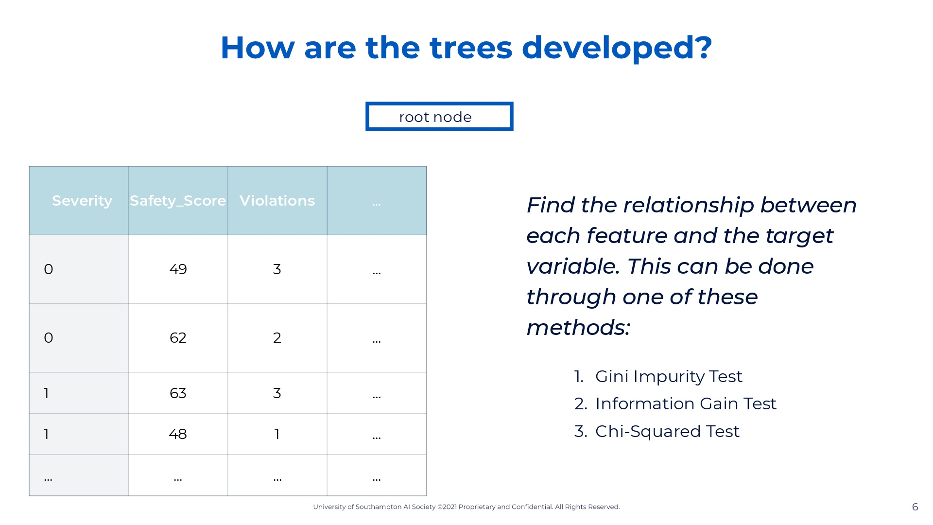
Notes:
The first is to find the root node. This root node is important because it is the first split we are going to do in our dataset.

Slide 7
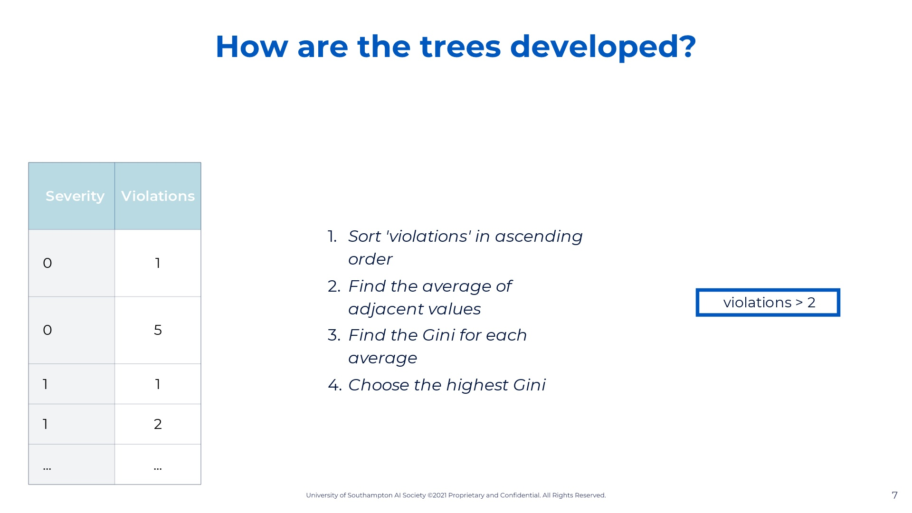
Notes:
The first is to find the root node. This root node is important because it is the first split we are going to do in our dataset.

Slide 8
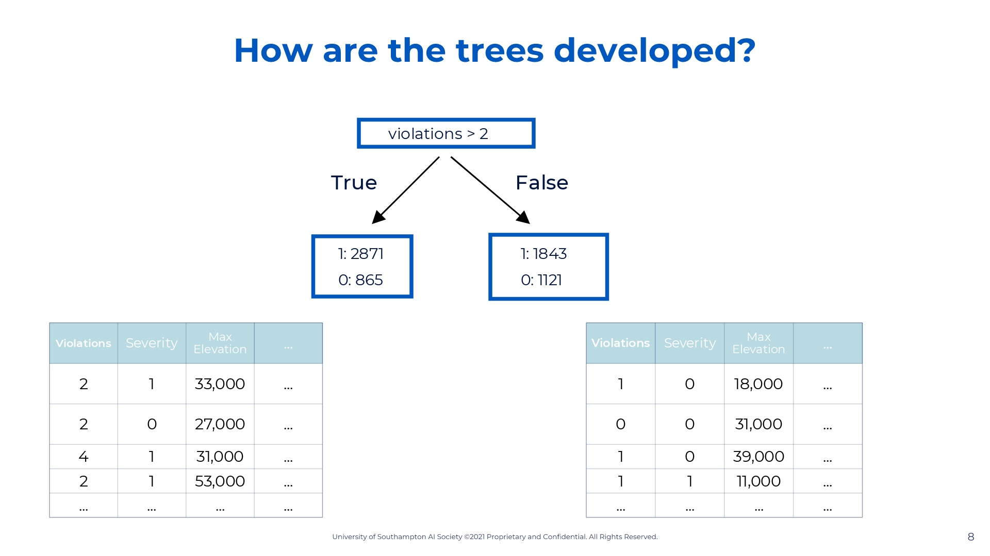
Notes:
The first is to find the root node. This root node is important because it is the first split we are going to do in our dataset.

Slide 9
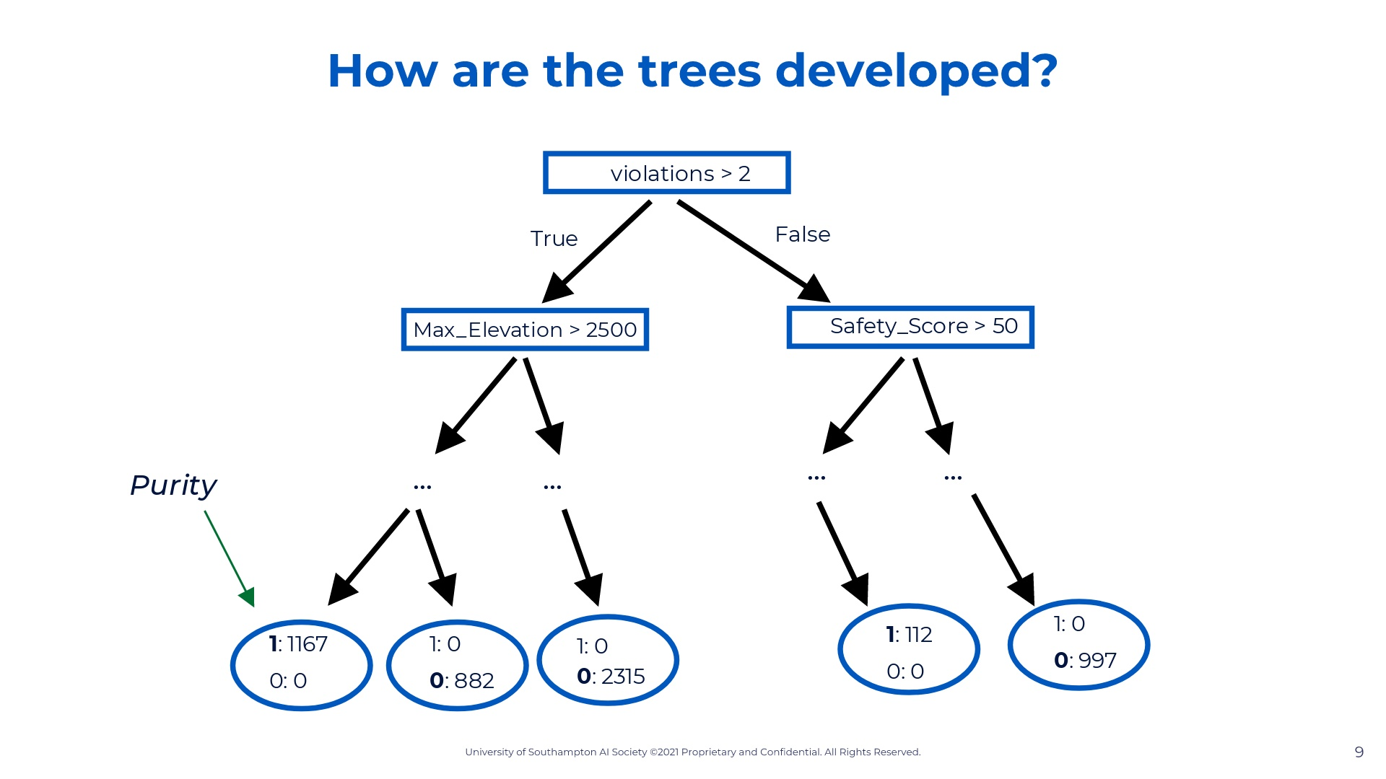
Notes:
A decision tree is a type of machine learning algorithm that creates a predictive model by learning simple decision rules from prior data. Decision trees are a supervised machine learning algorithm. This means that all our features and target variables are labelled, aka there are no missing values. Now in supervised algorithms there are regression model, where our target variable is continuous (ie. car price) and classification models, where our target variable is discrete (ie. car type). Decision trees actually fall under both of these, meaning that decision trees can be used for regression problems and classification problems. So immediately we can see one very powerful thing about decision trees. Let's look at a very simple classification decision tree here which is about whether someone should join AISoc or not. We begin by asking checking if they like ML. If yes, then we check if they want to learn about ML. If yes then the output is come to workshop. If not then the output is read kaggle. Let's go back to the if they like ML. Let's go through the false path. If they dont like ML we check if they like AI. If they do then they should come to talks, if not then goodbye because I have no recommendation. Therefore in this simple example we had a target variable with four classes: come to workshop, read, come to talks, bye. In order to reach one of the answers we used three features: likes ML, wants to learn, and likes AI. CHANGE: the example decision tree could be done on workshop data

Slide 10

Notes:
Show kaggle

Slide 11

Notes:
Show test results, how to improve and the decision tree itself + explain the evaluation methods

Slide 12
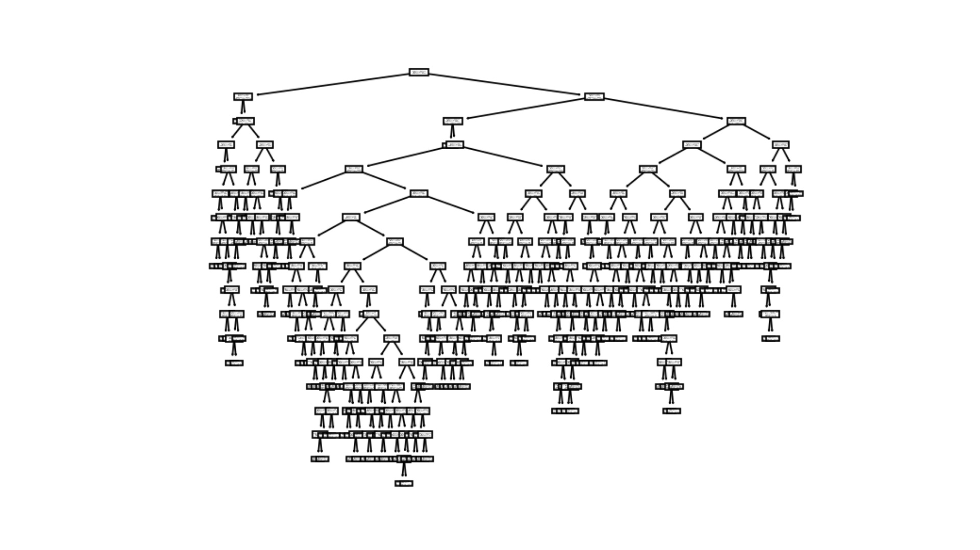

Slide 13
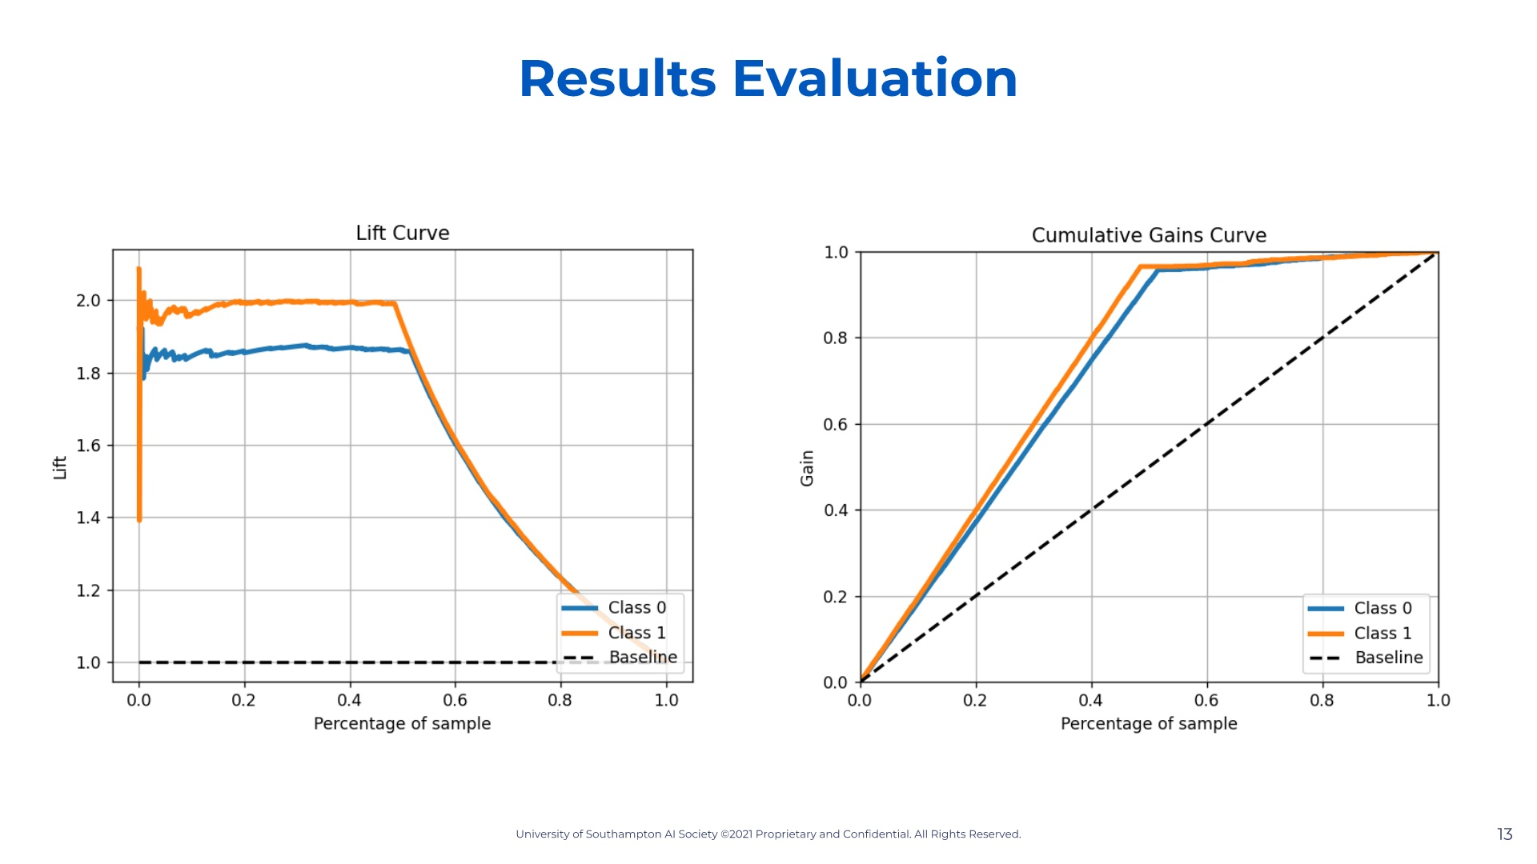
Notes:
A decision tree is a type of machine learning algorithm that creates a predictive model by learning simple decision rules from prior data. Decision trees are a supervised machine learning algorithm. This means that all our features and target variables are labelled, aka there are no missing values. Now in supervised algorithms there are regression model, where our target variable is continuous (ie. car price) and classification models, where our target variable is discrete (ie. car type). Decision trees actually fall under both of these, meaning that decision trees can be used for regression problems and classification problems. So immediately we can see one very powerful thing about decision trees. Let's look at a very simple classification decision tree here which is about whether someone should join AISoc or not. We begin by asking checking if they like ML. If yes, then we check if they want to learn about ML. If yes then the output is come to workshop. If not then the output is read kaggle. Let's go back to the if they like ML. Let's go through the false path. If they dont like ML we check if they like AI. If they do then they should come to talks, if not then goodbye because I have no recommendation. Therefore in this simple example we had a target variable with four classes: come to workshop, read, come to talks, bye. In order to reach one of the answers we used three features: likes ML, wants to learn, and likes AI. CHANGE: the example decision tree could be done on workshop data

Slide 14

Notes:
Check who won the previous challenge and announce at the beginning of the workshop no need to encode variables: https://www.kaggle.com/datasets/prathamtripathi/drug-classification show how to submit on kaggle

Slide 15
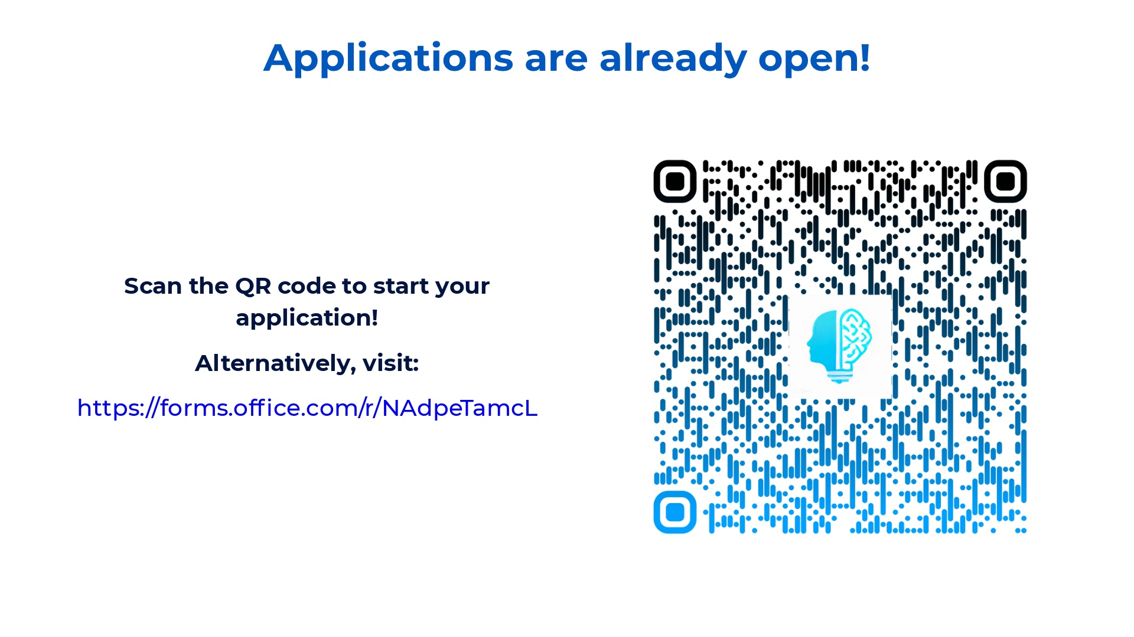

Slide 16

Notes:
We will also be present in the SUSU freshers fair in two days the entire day in the jubilee sports centre. On top of that we will be having our intro event Tuesday, where you can find free tickets on our eventbrite and in the linktree which was the QR code scanned previously. Note that the linktree can be found on our instagram and well remind you of this event on our social media.

